Slide 1
GE8151 Problem Solving and Python Programming
Rajasekaran S
Assistant Professor,
Department of Information Technology,
KGiSL Institute of Technology,
email: proffraja@gmail.com
Github:www.github.com/rajasekaranap

Slide 2
Control Statements
Control Statements
Conditional Control flow Statements
Unconditional Control flow Statements
Decision Making
Looping
Branching
continue
break
pass

Slide 3
pass
Pass is statement that deliberately defining to ignore the statement while interpreting.
Pass sometime’s used as place holder statements in a block.
When pass encountered in a block. It ignores the line and moves to next line.

Slide 4
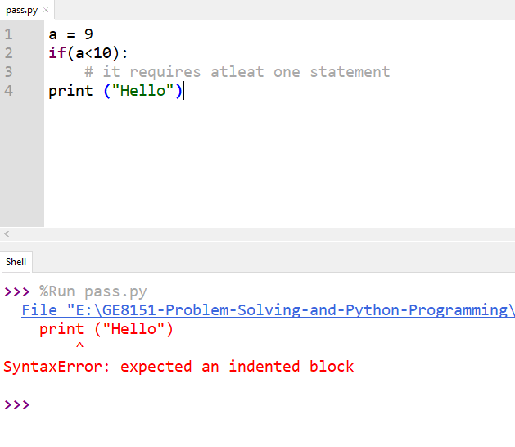
If block without pass
We have an error because, If block requires at least one line of statement after the expression.
We can put pass instead of anything.
Pass will do nothing.

Slide 5
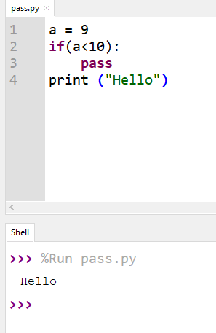
If block with pass
pass helped to solve the issue.
It act as place holder.
It can be used with function definitions too.

Slide 6
Functions
Functions are a block of code that does some specific operations.
It ensures modularity and reusability of the program.

Slide 7
Syntax
def function_name(parameters):
...
function block
...
return value

Slide 8
Parameters
Parameters are variables that receives values also known as formal parameters.
Sometimes values are passed as variables.
Variables used in function call is known as arguments it is also known as actual parameters.
Types
Formal Parameters
Actual Parameters

Slide 9
Pass by Value
It is process for copying value from actual parameter to formal parameter.
Actual parameter won’t be affected.
Ex
Changing the value

Slide 10
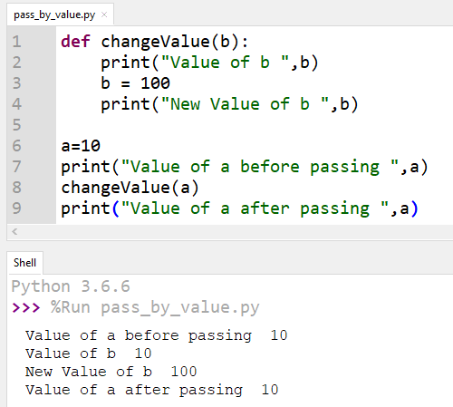
Pass By Value
Value of a is never changed.
Value of a is copied to b.

Slide 11
Pass by Reference
Here the reference of the actual parameter is passed.
So change of value of formal parameters affects actual parameters value.
Ex
Changing the list

Slide 12
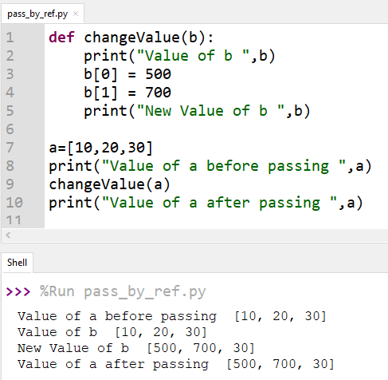
Pass By Reference
Value of a is changed.

Slide 13
Scope of the Variables
The scope of a variable refers to the places that we can see or access a variable.
If we define a variable on the top of the script or module, the variable is called global variable.
The variables that are defined inside a class or function is called local variable.

Slide 14
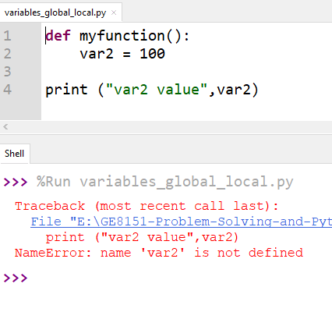
Local Variables
Var2 is local variable of myfunction block
It cannot be accessed or referred outside of the function block

Slide 15
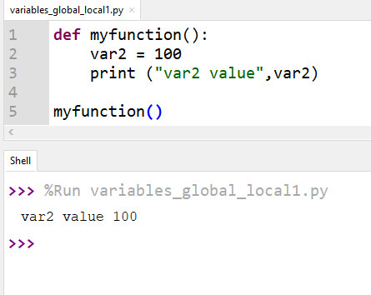
Local Variables
Var2 Displayed inside the function block.

Slide 16
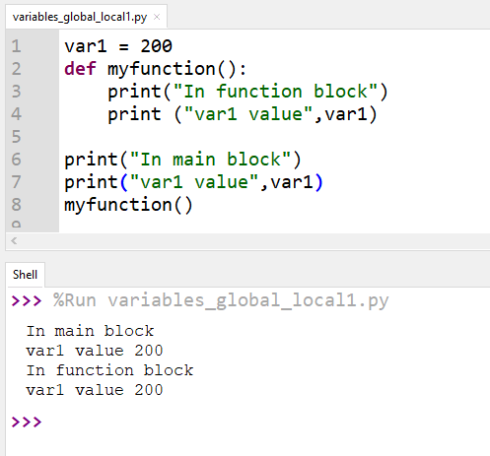
Global Scope
Var1 can be accessed anywhere in the program.

Slide 17
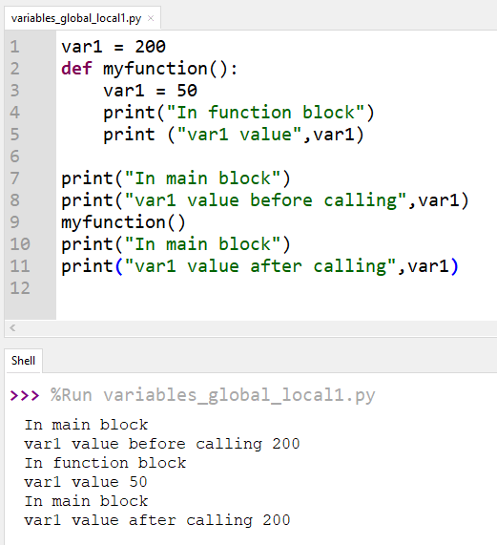
Global Scope
Change of global variables inside block won’t affect the actual value.

Slide 18
Function Composition
Calling one function from another is called composition. If F(x) and G(x) are two functions then its composition is given as F(G(x)).
That is passing result of one function as argument to the other function is known as function composition.

Slide 19
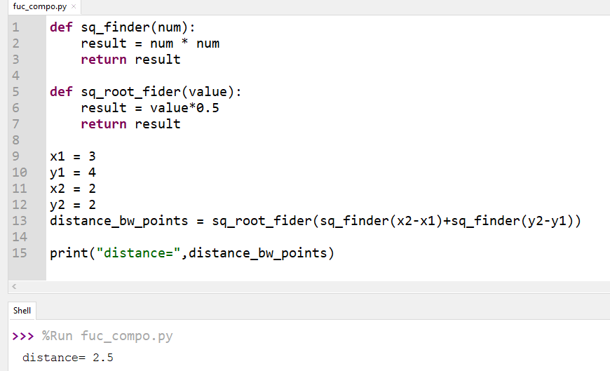
Function calls chained

Slide 20
Anonymous Functions [Python Lambda’s]
This function can have any number of arguments but only one expression, which is evaluated and returned.
One is free to use lambda functions wherever function objects are required.
You need to keep in your knowledge that lambda functions are syntactically restricted to a single expression.
It has various uses in particular fields of programming besides other types of expressions in functions.

Slide 21
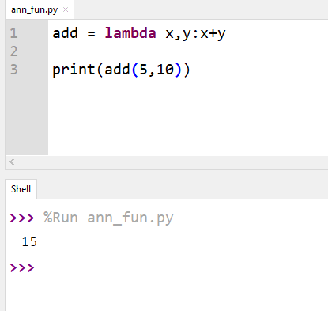
Example

Slide 22
Recursive functions
The process in which a function calls itself directly or indirectly is called recursion and the corresponding function is called as recursive function.
Ex:
Finding Factorial of a number

Slide 23
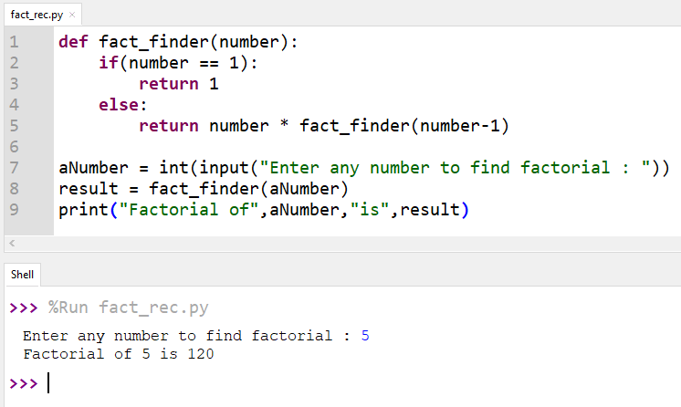
Finding Factorial of a number using recursive function

Slide 24
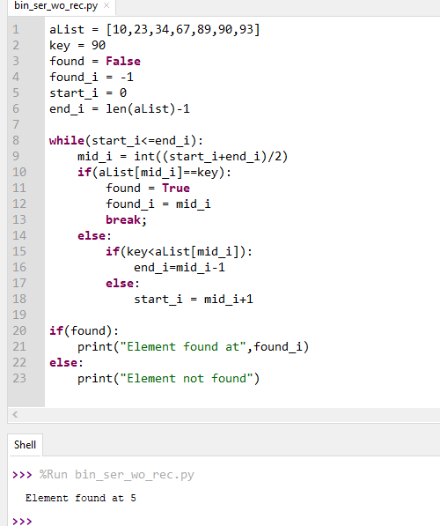
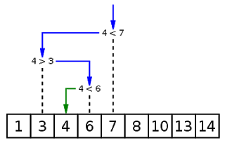
Binary Search

Slide 25
Strings
A String is sequential collection of characters.
It is collections of alphabets, numbers, special characters.
It is represented with double quotes (“”)
Eg:
“Hello World
”

Slide 26
String Operations
String printing
String slicing
Printing each character

Slide 27
Important String functions
capitalize()
Capitalizes first letter of string
center(width, fillchar)
Returns a space-padded string with the original string centered to a total of width columns.
count(sub)
Count number of occurrences of sub in string

Slide 28
Important String functions
find(str)
Determine if str occurs in string or in a substring of string returns index if found and -1 otherwise.
index(str)
Same as find(), but raises an exception if str not found.

Slide 29
Important String functions
isalnum()
Returns true if string has at least 1 character and all characters are alphanumeric and false otherwise.
isalpha()
Returns true if string has at least 1 character and all characters are alphabetic and false otherwise.
isdigit()
Returns true if string contains only digits and false otherwise.

Slide 30
Important String functions
lower()
Converts all uppercase letters in string to lowercase.
rfind(str)
Same as find(), but search backwards in string.
rindex(str)
Same as index(), but search backwards in string.
split(delimiter)
It splits string based on delimiter and return list of strings

Slide 31
Array’s

Slide 32
Thank You
Rajasekaran S
Assistant Professor,
Department of Information Technology,
KGiSL Institute of Technology,
email: proffraja@gmail.com
Github:www.github.com/rajasekaranap

